Slide 1
Hive sorting, join and subqueries

Slide 2
Sorting
ORDER BY is used for producing globally sorted data
However, can be slow since it uses just 1 reducer to produce a total sort
Newer versions of Hive will improve on this.
If we are happy with data just stored within each reducer but not globally sorted.
Then use SORT BY
This is much faster than ORDER BY since we can use more than 1 reducer.

Slide 3
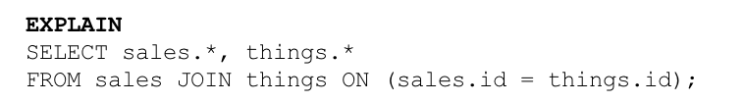
Explain
You can get Hive to show you the query execution plan using the EXPLAIN command.
More detailed execution plan is available using
EXPLAIN EXTENDED

Slide 4
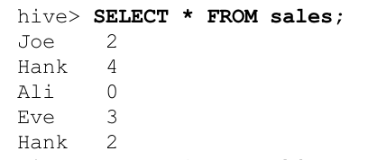
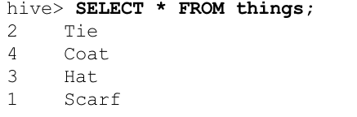

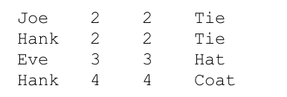
Inner Join
Inner joins are easy, see above

Slide 5
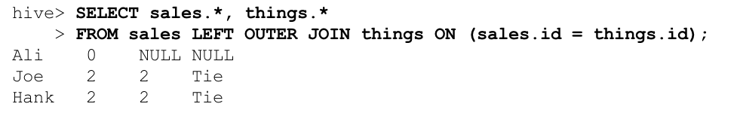

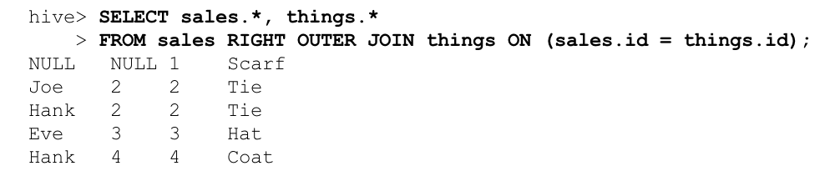
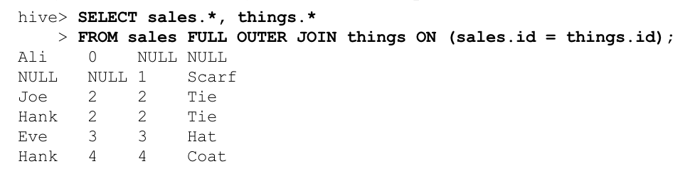
Outer Joins

Slide 6
Subqueries
Subqueries are supported in both the FROM and WHERE clause.
Here is an example of subqueries in the FROM clause
SELECT col
FROM (
SELECT a+b AS col
FROM t1
) t2
In the above example a subquery is used in the FROM clause to create temporary table which is used by the outer query.
The AS keyword is used to give a name for the column inside the temporary table.

Slide 7
Subqueries
SELECT col1, col2
FROM table1
JOIN (
SELECT col3, COUNT(col1) AS c1
FROM table1
GROUP BY col3
SORT BY col1
LIMIT 15
) myt ON table1.col3 = myt.col3;
Example of Hive supporting join queries from the FROM clause

Slide 8
Subqueries in WHERE clause
SELECT state, net_payments
FROM transfer_payments
WHERE transfer_payments.year IN (SELECT year FROM us_census)

